Slide 1


01/15
TELECOMMUNICATION USER ANALYTICS
~ JASPREET KAUR

Slide 2

02/15
1. Business Context
2. User Overview Analysis
3. User Engagement Analysis
4. User Experience Analysis
5.User Satisfaction Analysis
6. Recommendations
7. Expected Business Impact
8. References
AGENDA

Slide 3



03/15
BUSINESS CONTEXT
1. Investor evaluating TellCo (telecom operator in Pefkakia).
2. Objective: Assess engagement, experience, satisfaction.
3. Goal: Recommend profitability & growth strategies.

Slide 4

04/15
1. Top 10 handsets identified.
2. Top 3 manufacturers dominate market share.
3. Recommendation: Target promotions with top brands
USER OVERVIEW – HANDSETS & MANUFACTURERS

Slide 5

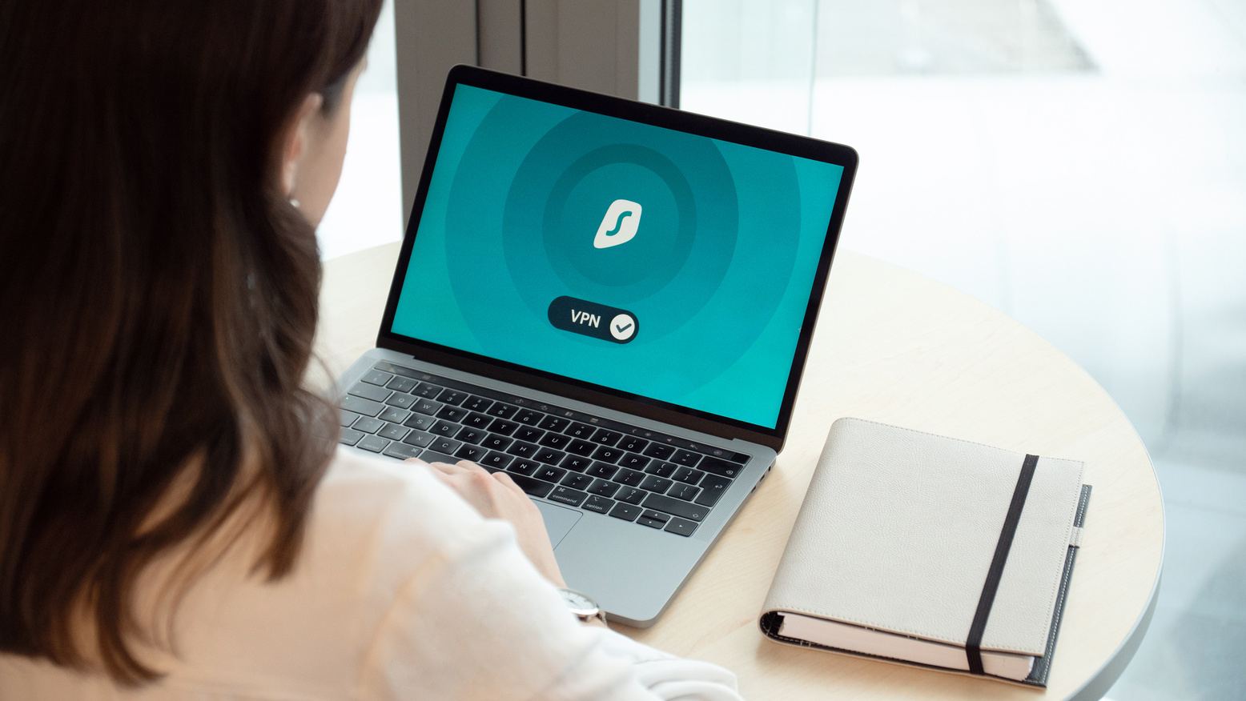

05/15
USER OVERVIEW – APPLICATION USAGE
Most data consumed on YouTube, Social Media, ~ Netflix.
Lower usage on Gaming & Email.
Recommendation: Offer bundles for video & social media.

Slide 6

06/15
ENGAGEMENT ANALYSIS – METRICS
Features: Session frequency, duration, total traffic.
Top 10 most engaged users identified.
Heavy users drive majority of traffic.

Slide 7
07/15
ENGAGEMENT ANALYSIS – CLUSTERING
Cluster 0 – Low engagement.
Cluster 1 – Medium engagement.
Cluster 2 – High engagement (power users).

Slide 8


08/15
High-engagement users: Offer premium plans.
Low-engagement users: Introduce retention offers.
Medium users: Targeted upselling campaigns
ENGAGEMENT RECOMMENDATIONS

Slide 9
09/15
EXPERIENCE ANALYSIS –
Network metrics: RTT, Throughput, TCP retransmissions.
Performance varies by handset type.
´Identified poor, average, good experience users.
METRICS

Slide 10
10/15
Good experience: High throughput, low RTT.
Average experience: Balanced network quality.
Poor experience: High delays & retransmissions
EXPERIENCE ANALYSIS –
CLUSTERING

Slide 11
11/15
EXPERIENCE RECOMMENDATIONS
Prioritize network optimization for poor clusters.
Focus on rural areas & older handsets.
Maintain quality for high-value users.

Slide 12
12/15
SATISFACTION ANALYSIS – MODEL
Satisfaction = Engagement + Experience.
Models tested: Logistic Regression, Decision Tree, Random Forest.
Best performance: Random Forest

Slide 13
10/15
SATISFACTION CLUSTERING
Low satisfaction → High churn risk.
High satisfaction → Loyal customers.
Model predicts daily churn risk.

Slide 14
10/15
SATISFACTION RECOMMENDATIONS
Deploy predictive model in production.
Monitor churn risk daily.
Use discounts, free trials, loyalty campaigns

Slide 15
Final Recommendations
Acquire TellCo – strong potential in video & social.
Focus on high-engagement segments.
Improve network quality for at-risk clusters.
Deploy satisfaction model company-wide.

Slide 16
15/15
THANK
YOU!

